Slide 1
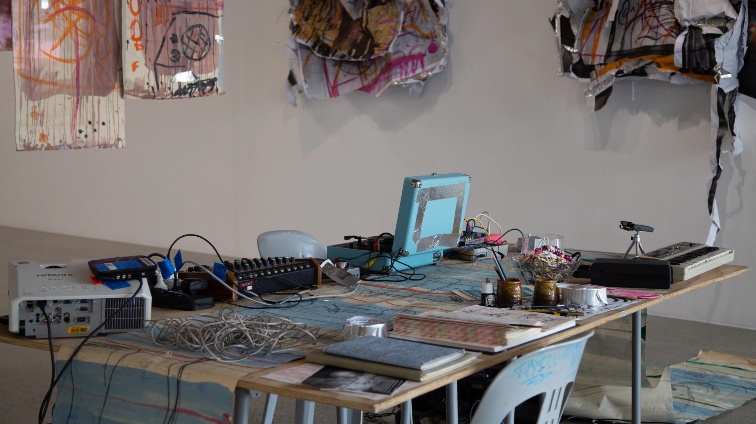
Laying the noise table
As an initial meeting place for my research, I come to a table to evoke wilful presence, social gathering, hosting, and temporality. The potent site of a table is a space for the holding and rearranging of human and object relations that dance between the archival modes of time and selection and the performance modes of sharing and production.

Slide 2
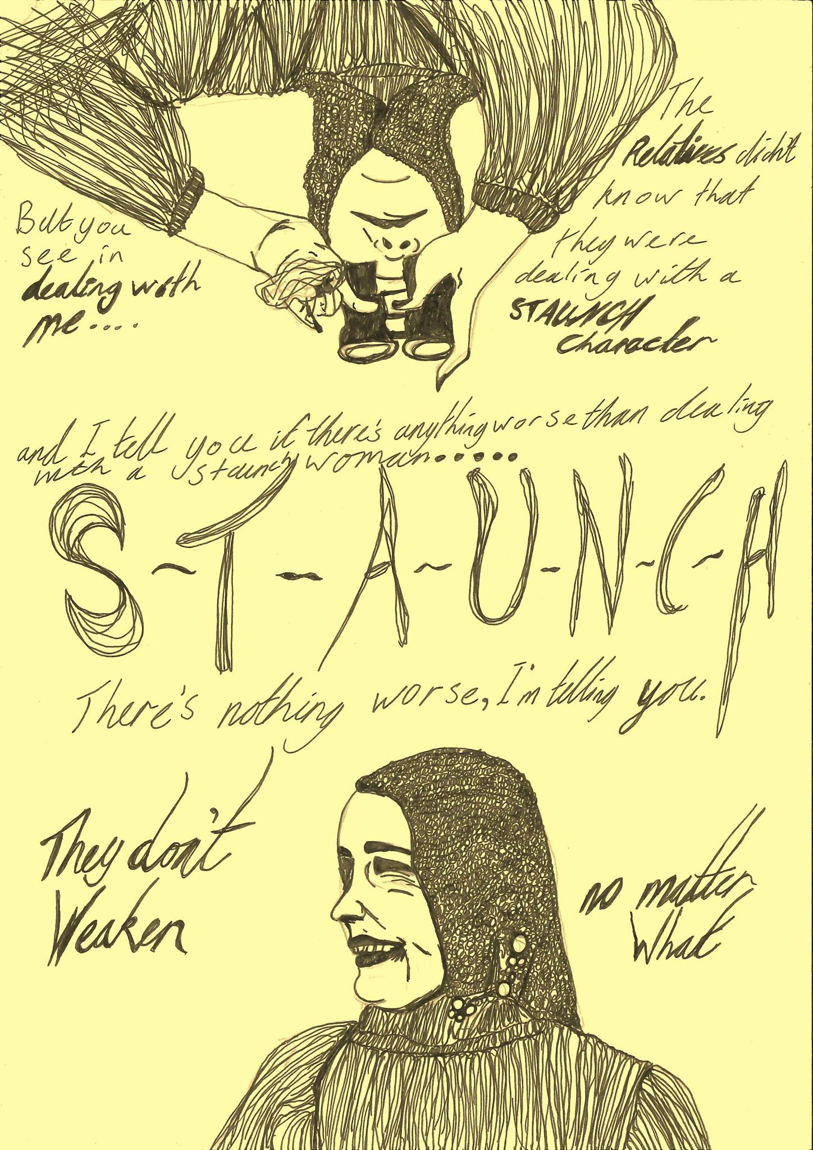
PGR9
Proposal introduction:
My established art practice sits within a feminist methodology that connects me to my communities with strategies of improvised performance, and social collective actions. Directed by an audio-visual drawing installation practice, my research is concerned with the material potential of temporary dwelling in social spaces. Through generative actions of installation, I explore how art can dismantle urban social inequities and assertively improvise ways of building more just and joyful spaces together. Audio-visual installations that apply radical attentiveness (deep listening, drawing, and reading) to social spaces invite consideration of the immediate surroundings, along with introspection and consideration of our roles within these spaces. Aspects of contingency are implicit and operate alongside improvisation in both my sound and visual work. As the performer-operator (diva) of this practice-led research, I ask what it is to be working as a creative person performing multiple disciplines while accounting for broader intersectional views on identity and community.
Keywords: audio-visual; sound; drawing; feminism; improvisation; installation; narrative; performance; poststructuralism; semiotics; site; trace; urban

Slide 3
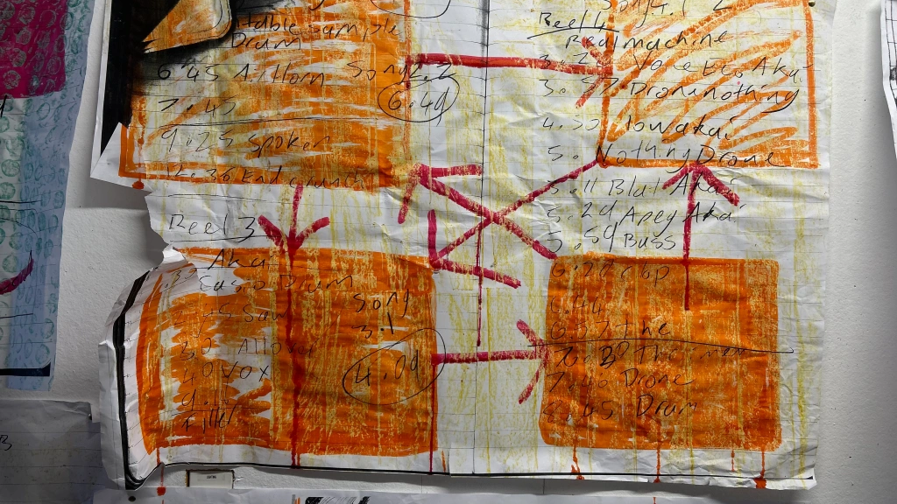
Block diagram of the signal-flow for a feedback loop
Here I am scribbling my way in
What is that seeping through?
Listening to the scraps
A re-emergence unfolding
Feedback

Slide 4
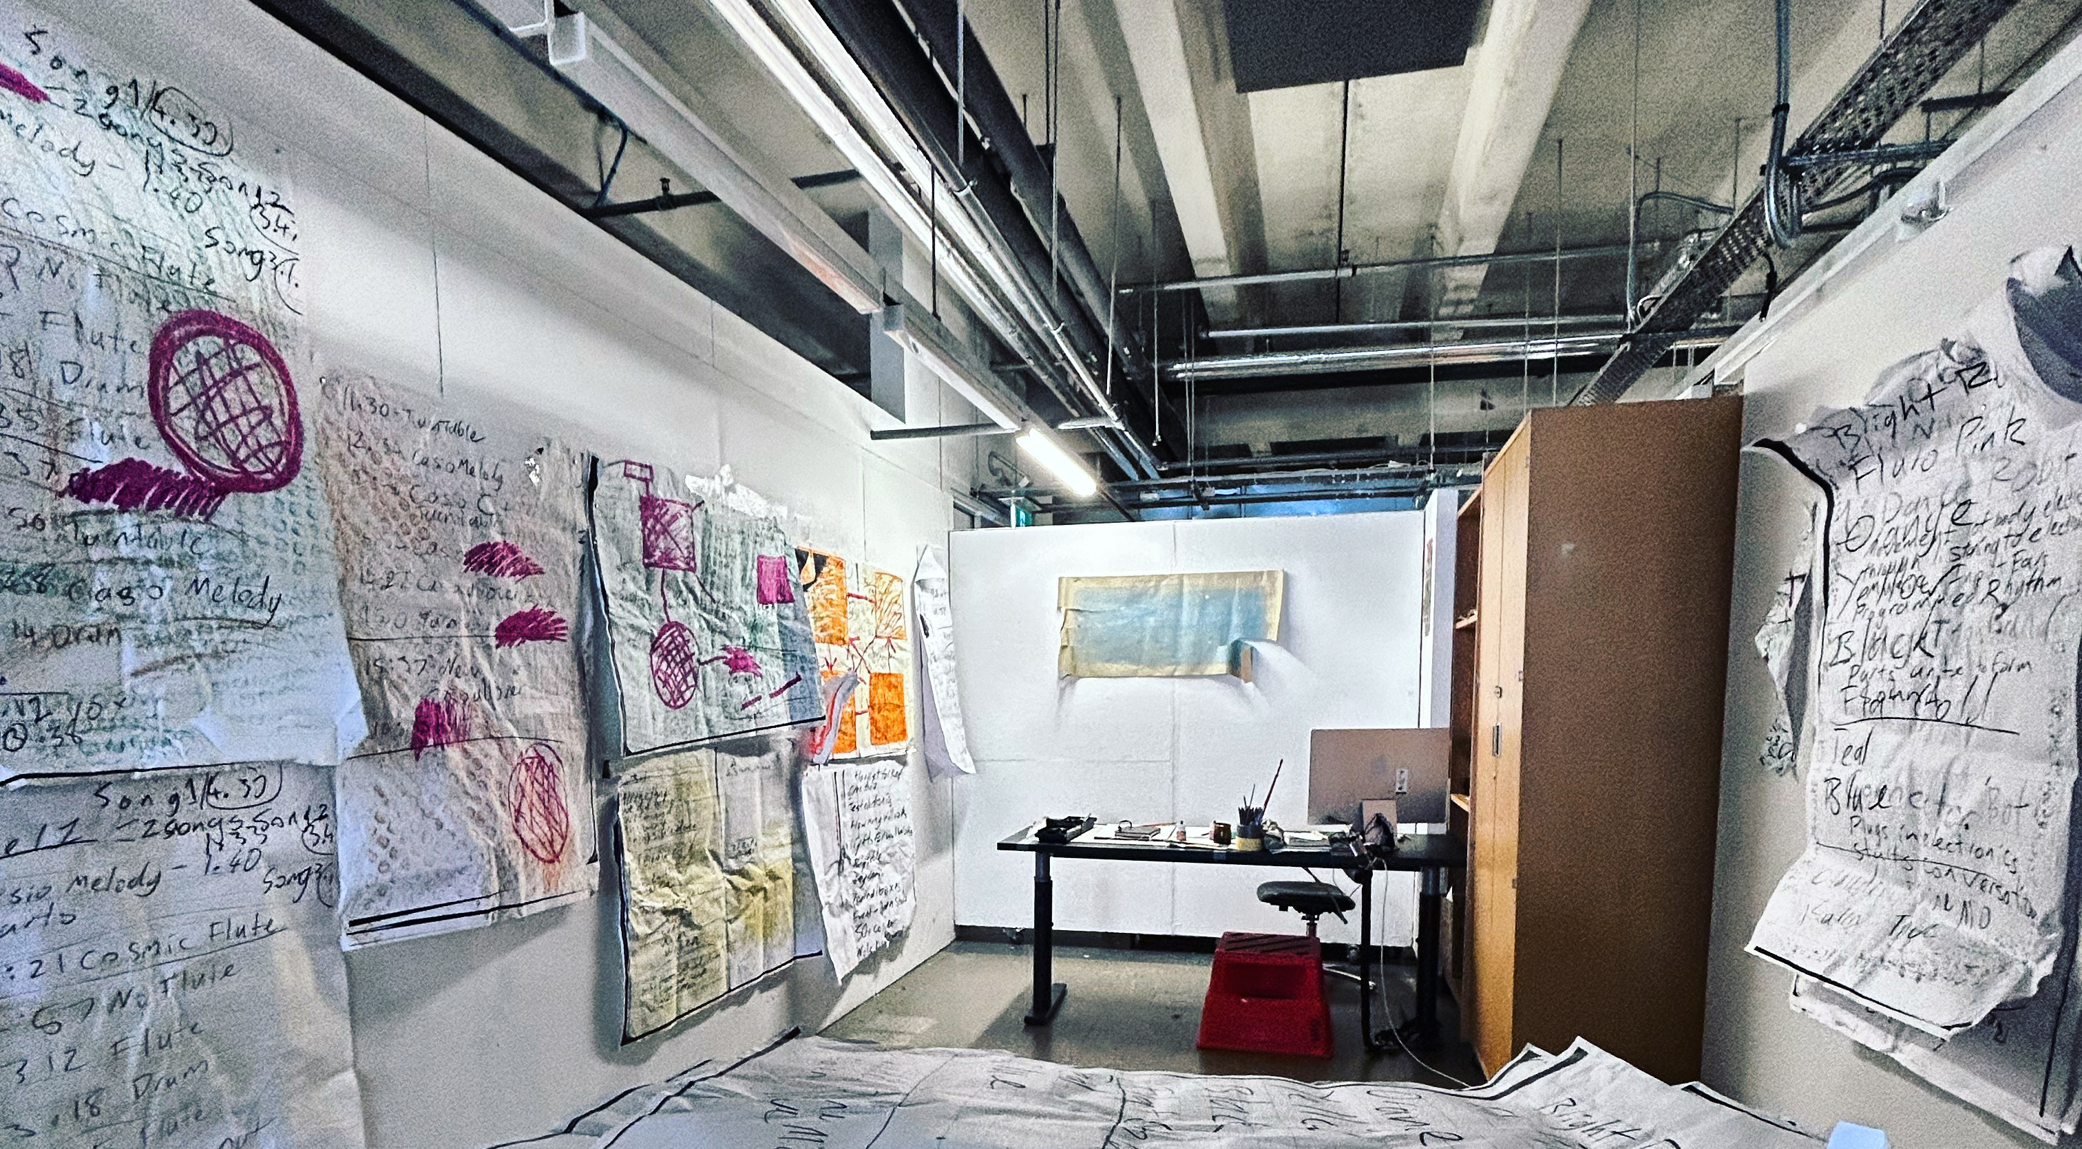
My studio where I have been shuffling bits of paper.

Slide 5
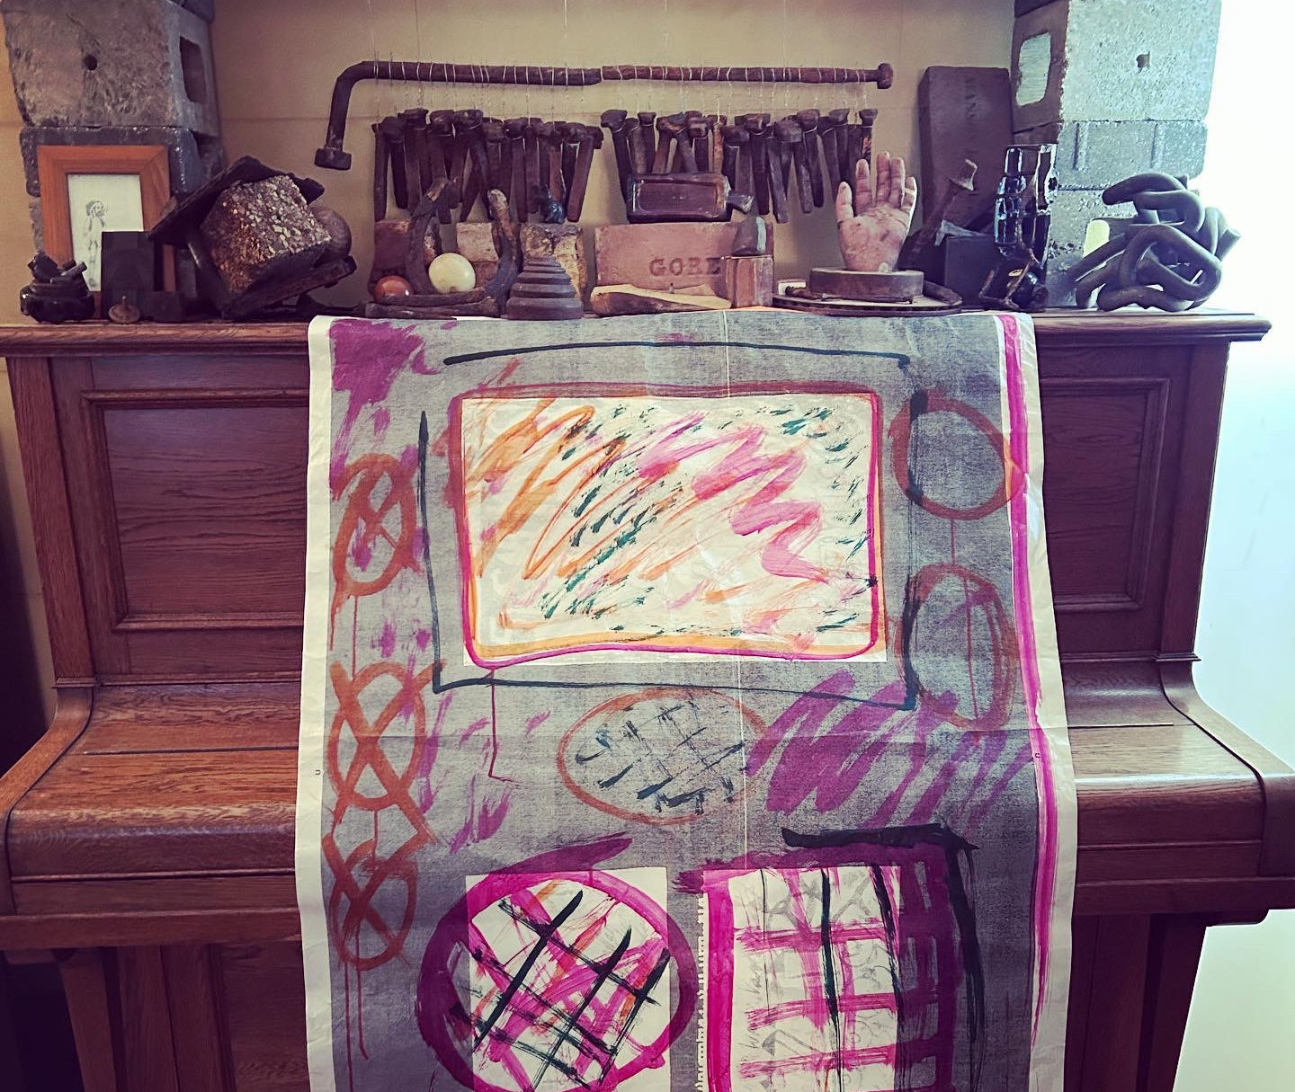
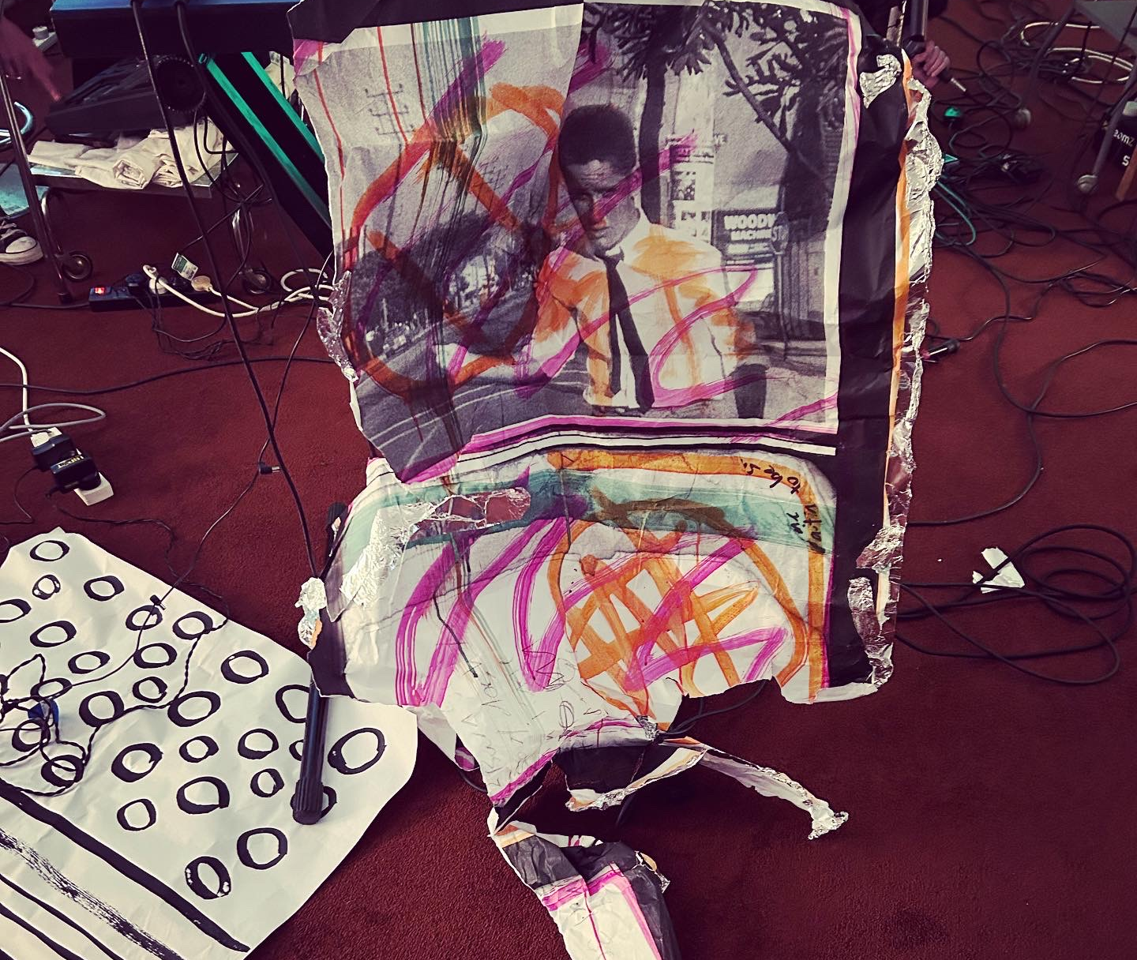
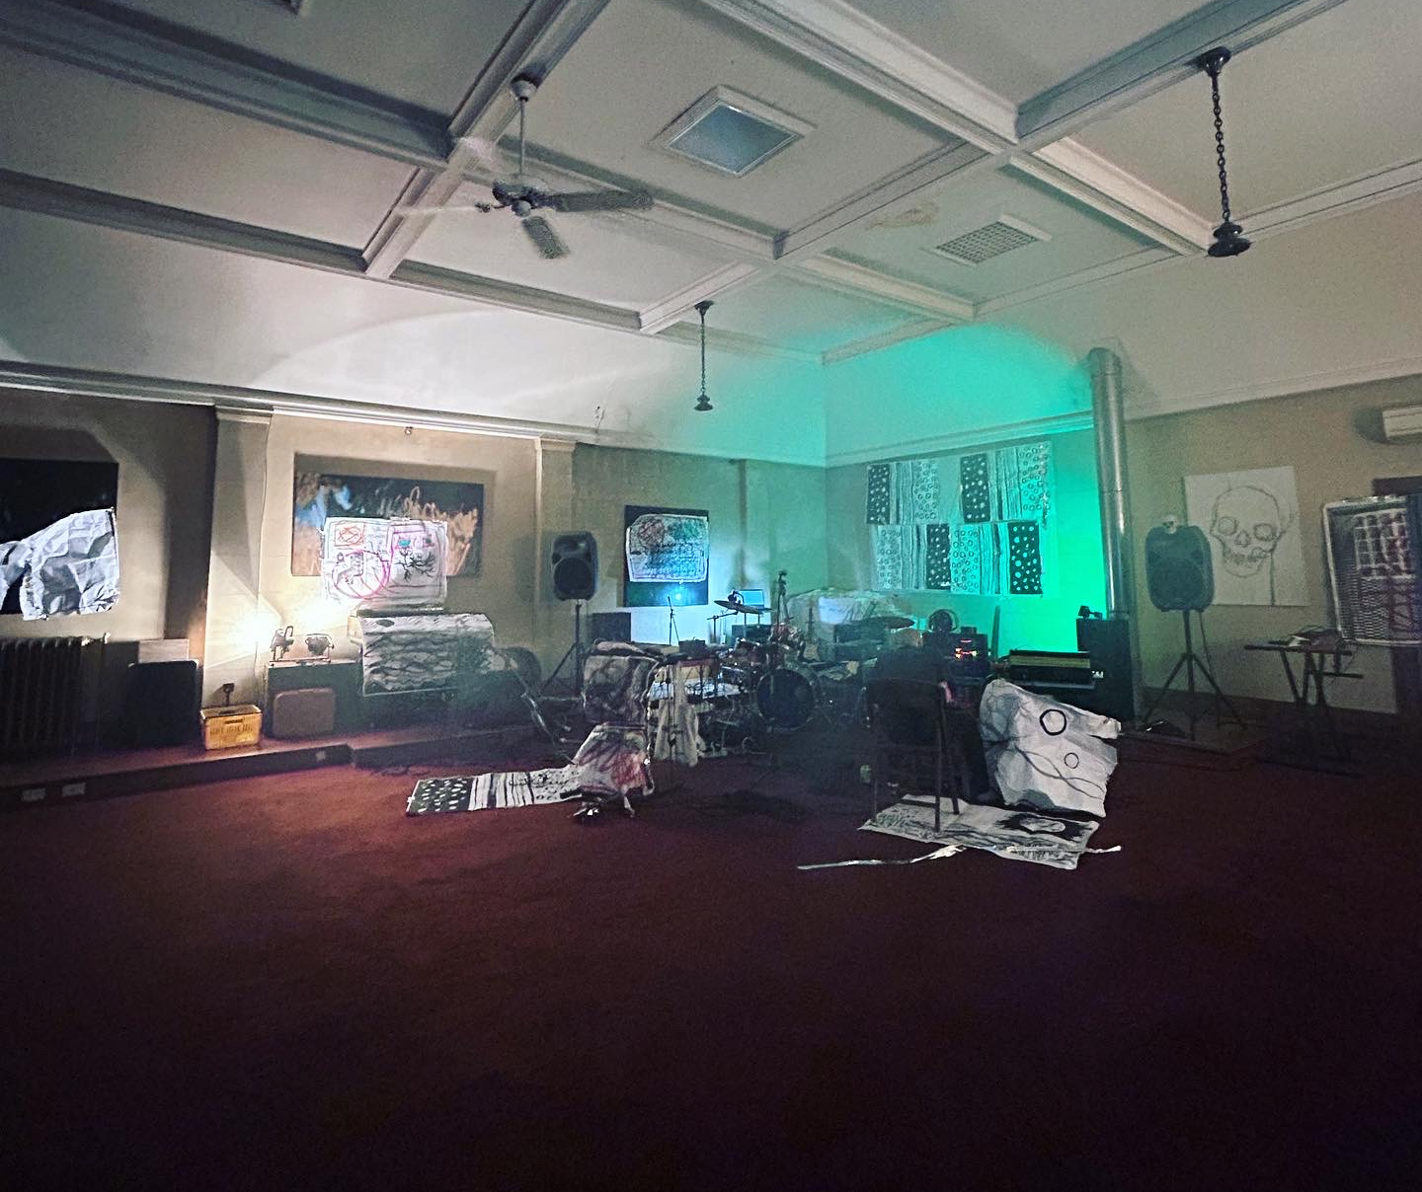
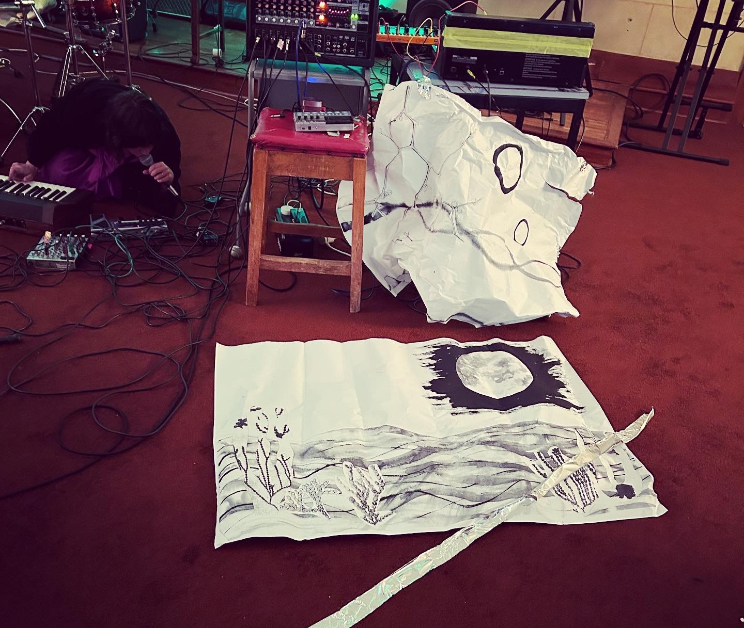
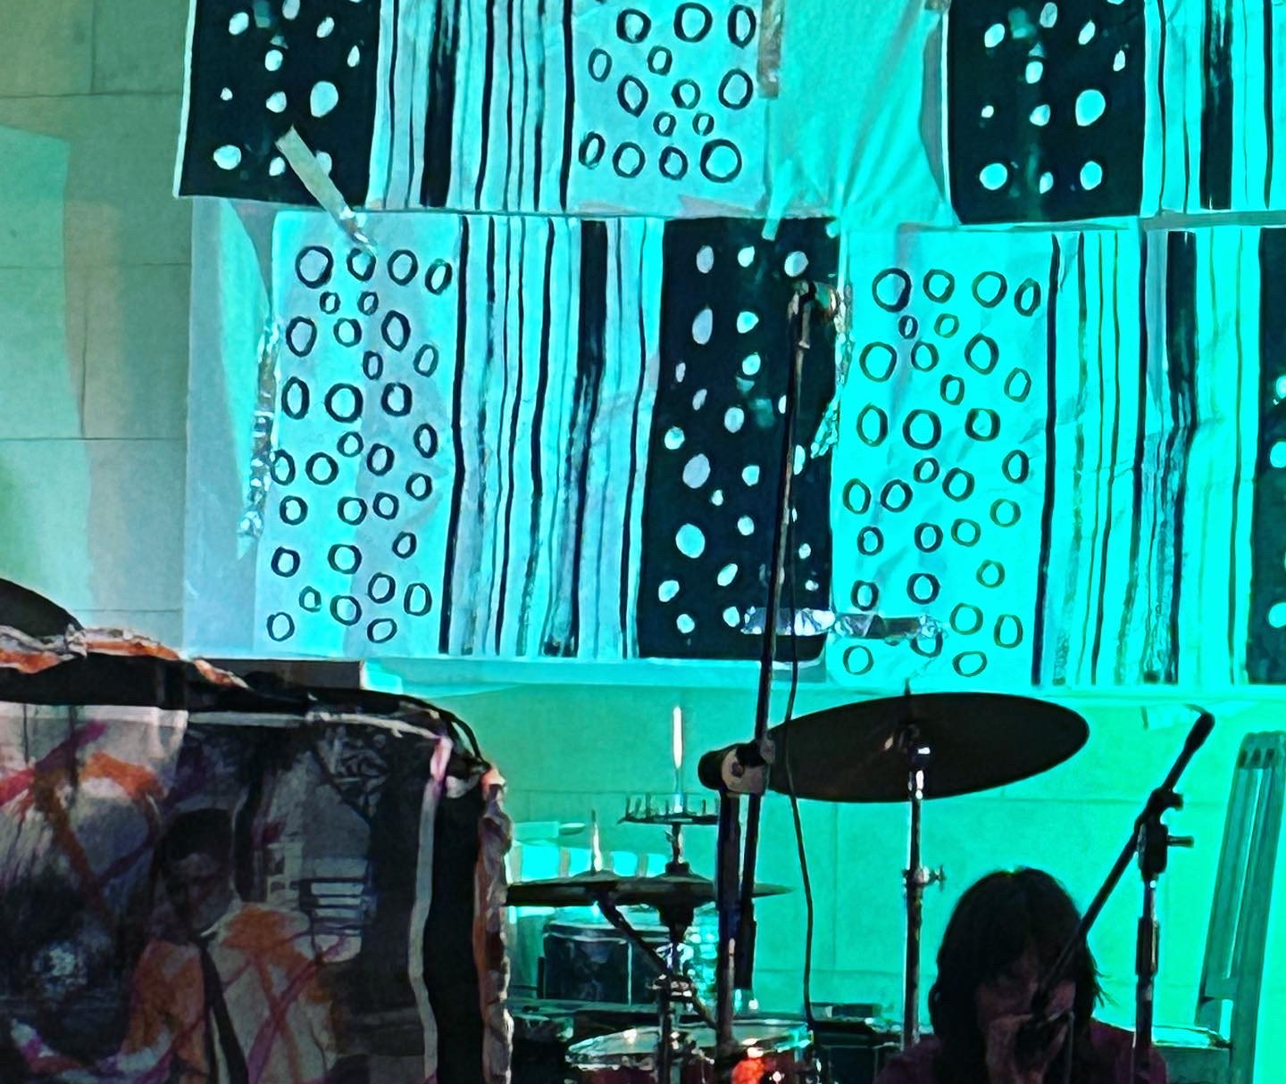
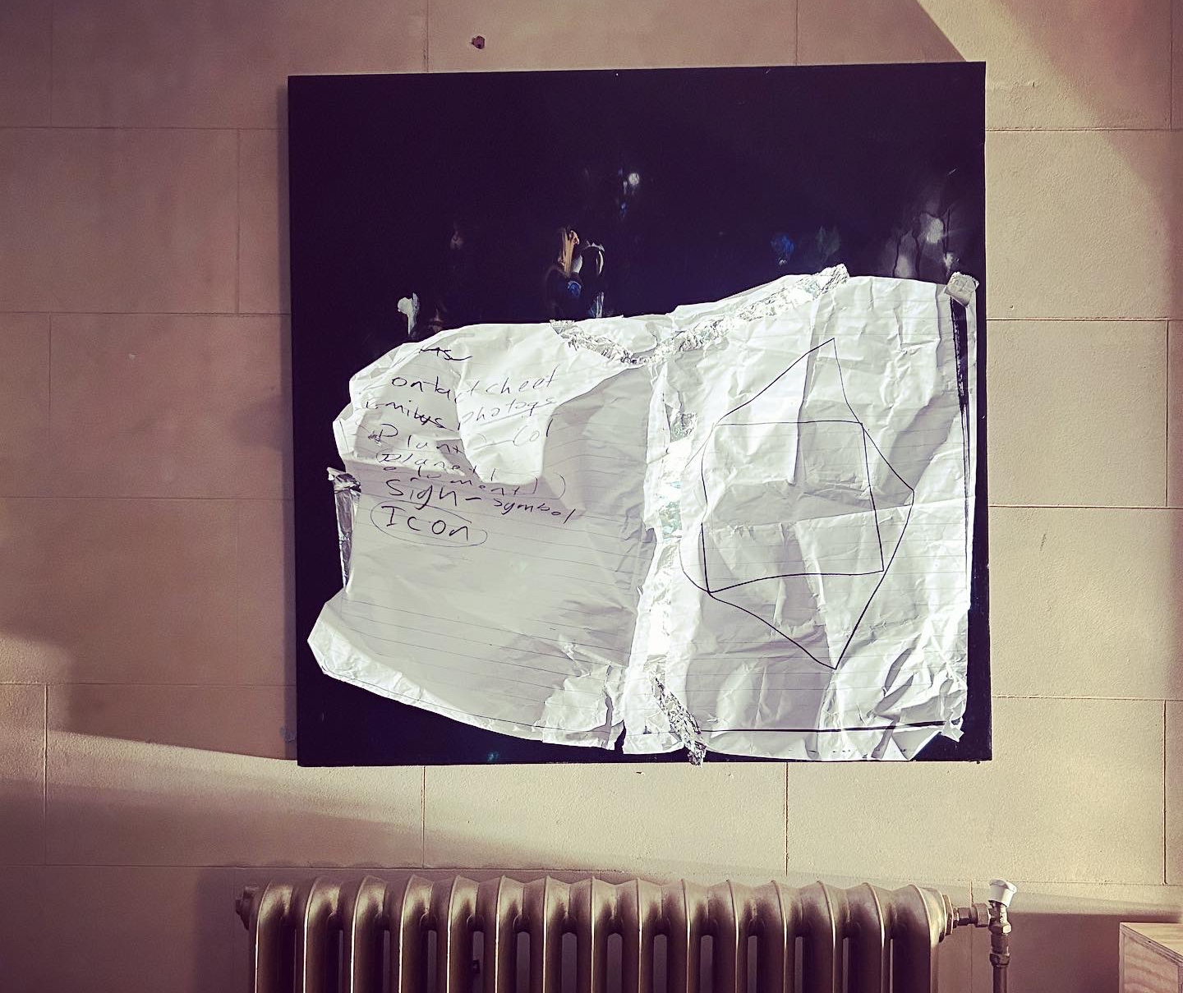

Slide 6
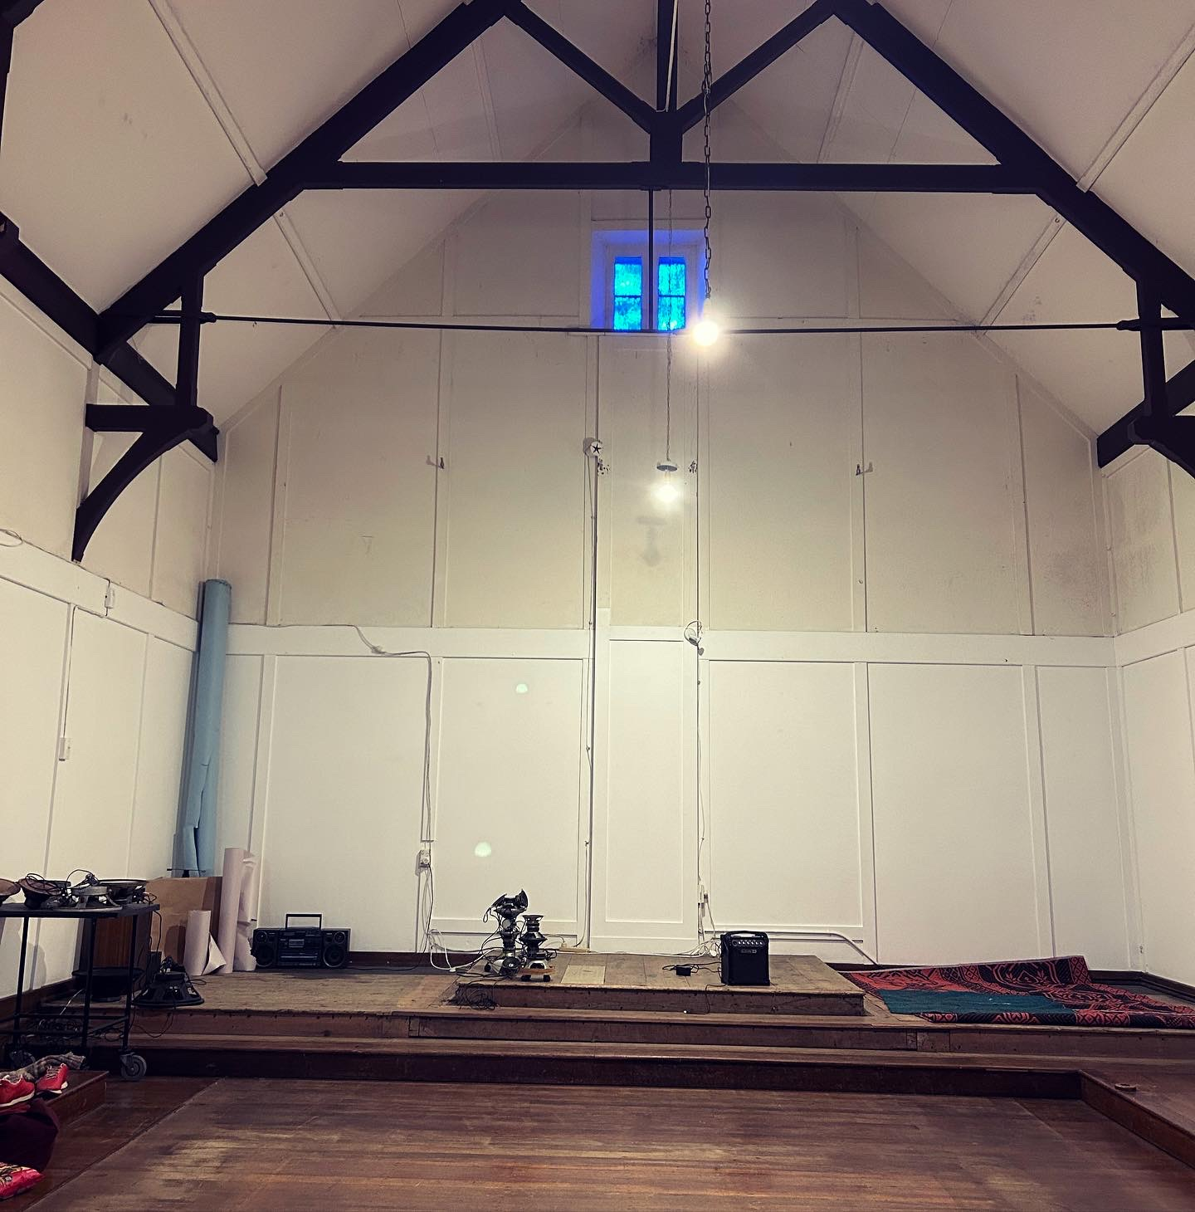
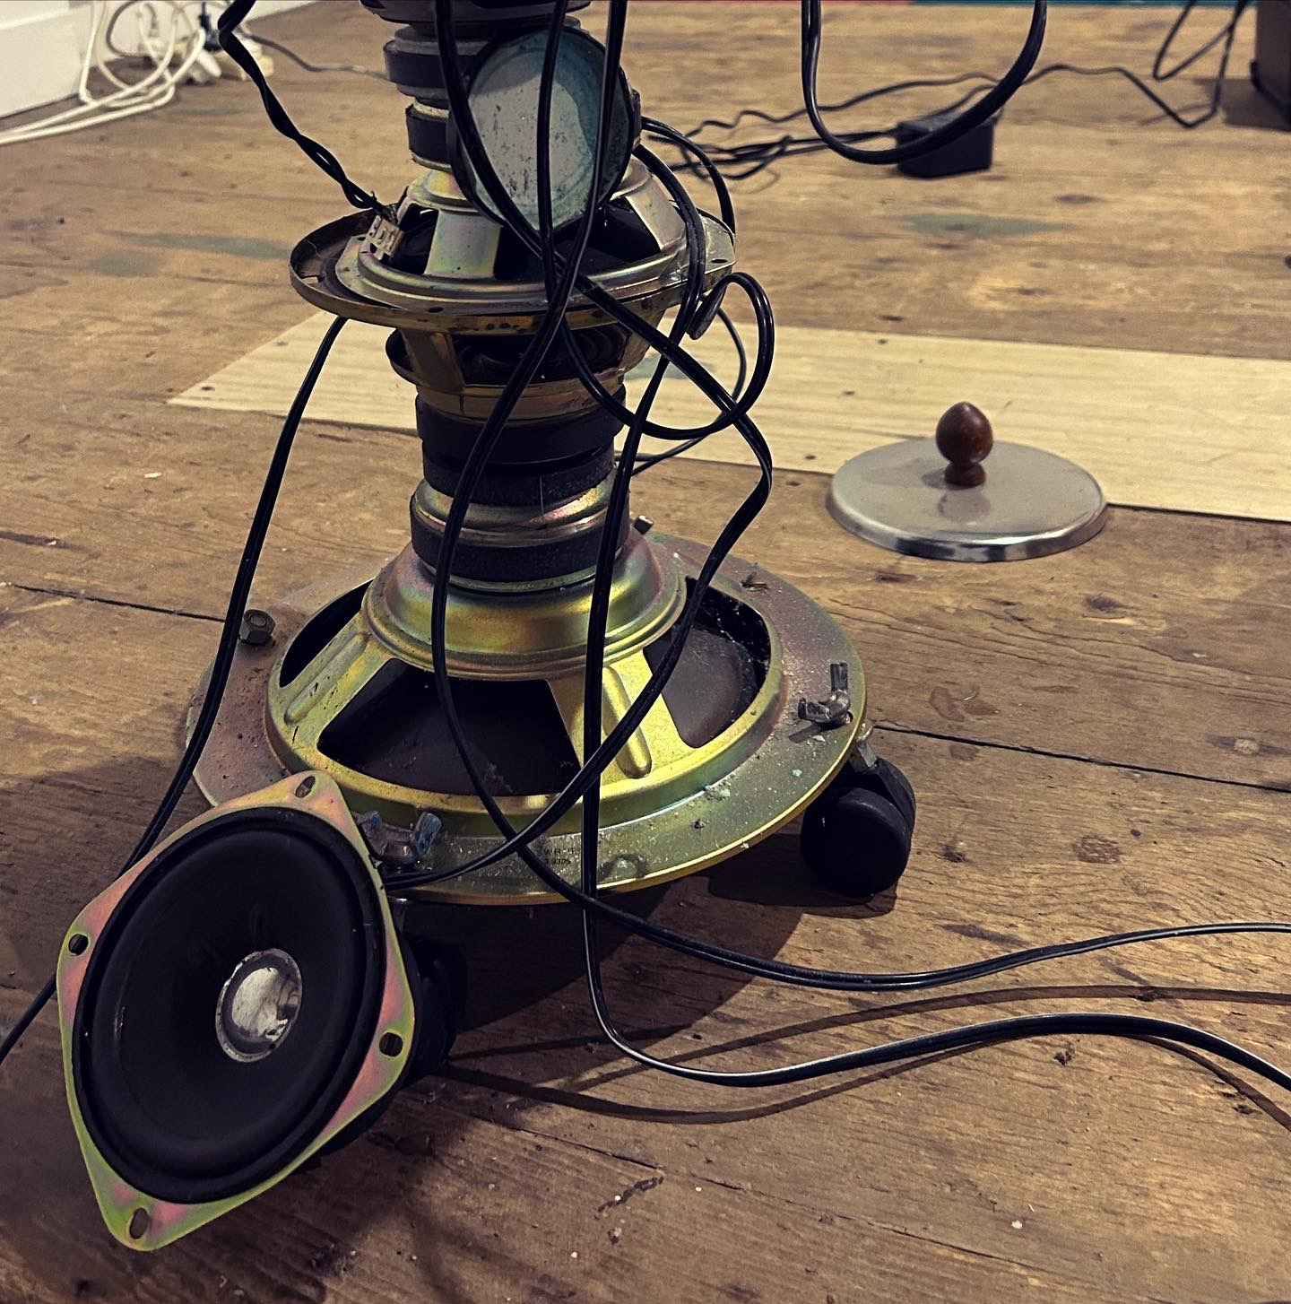
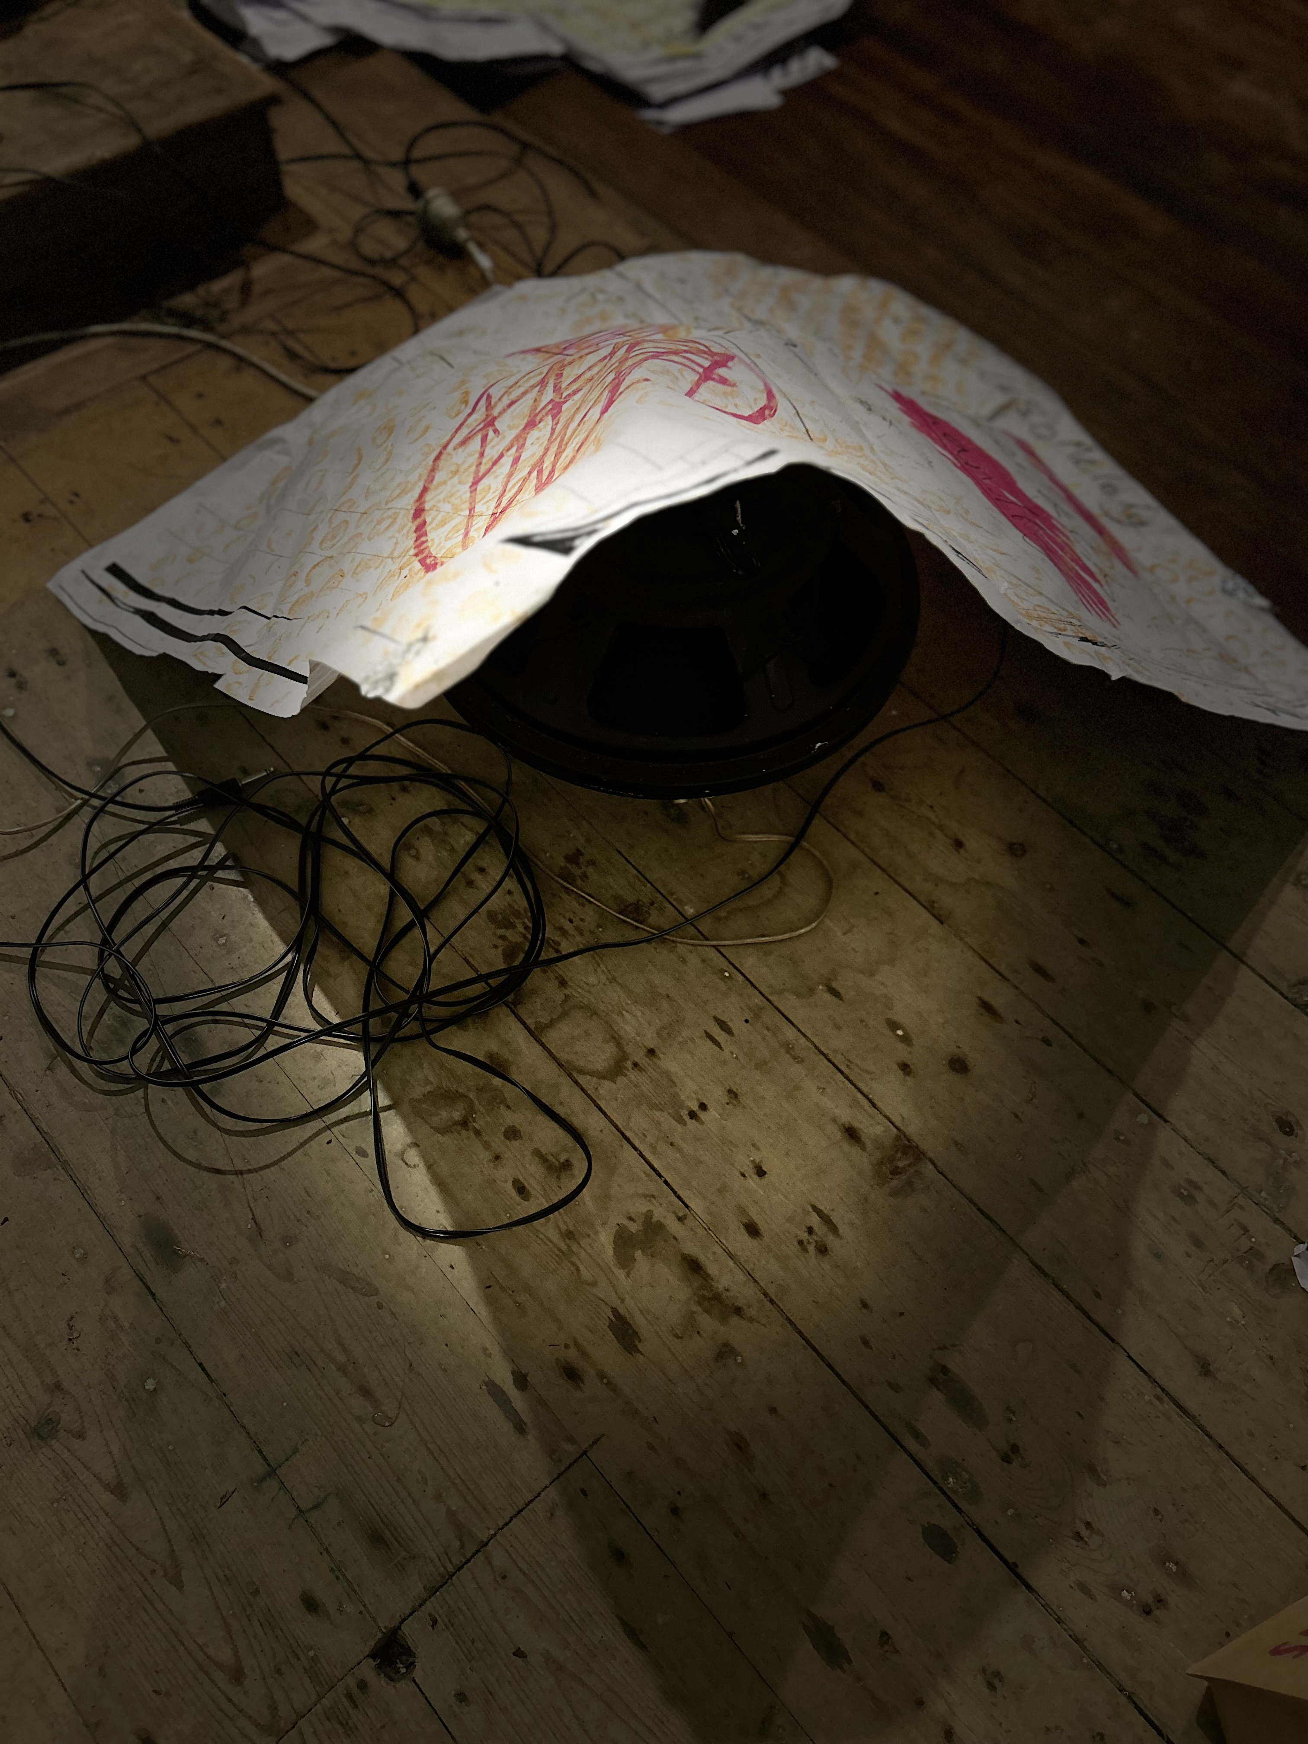
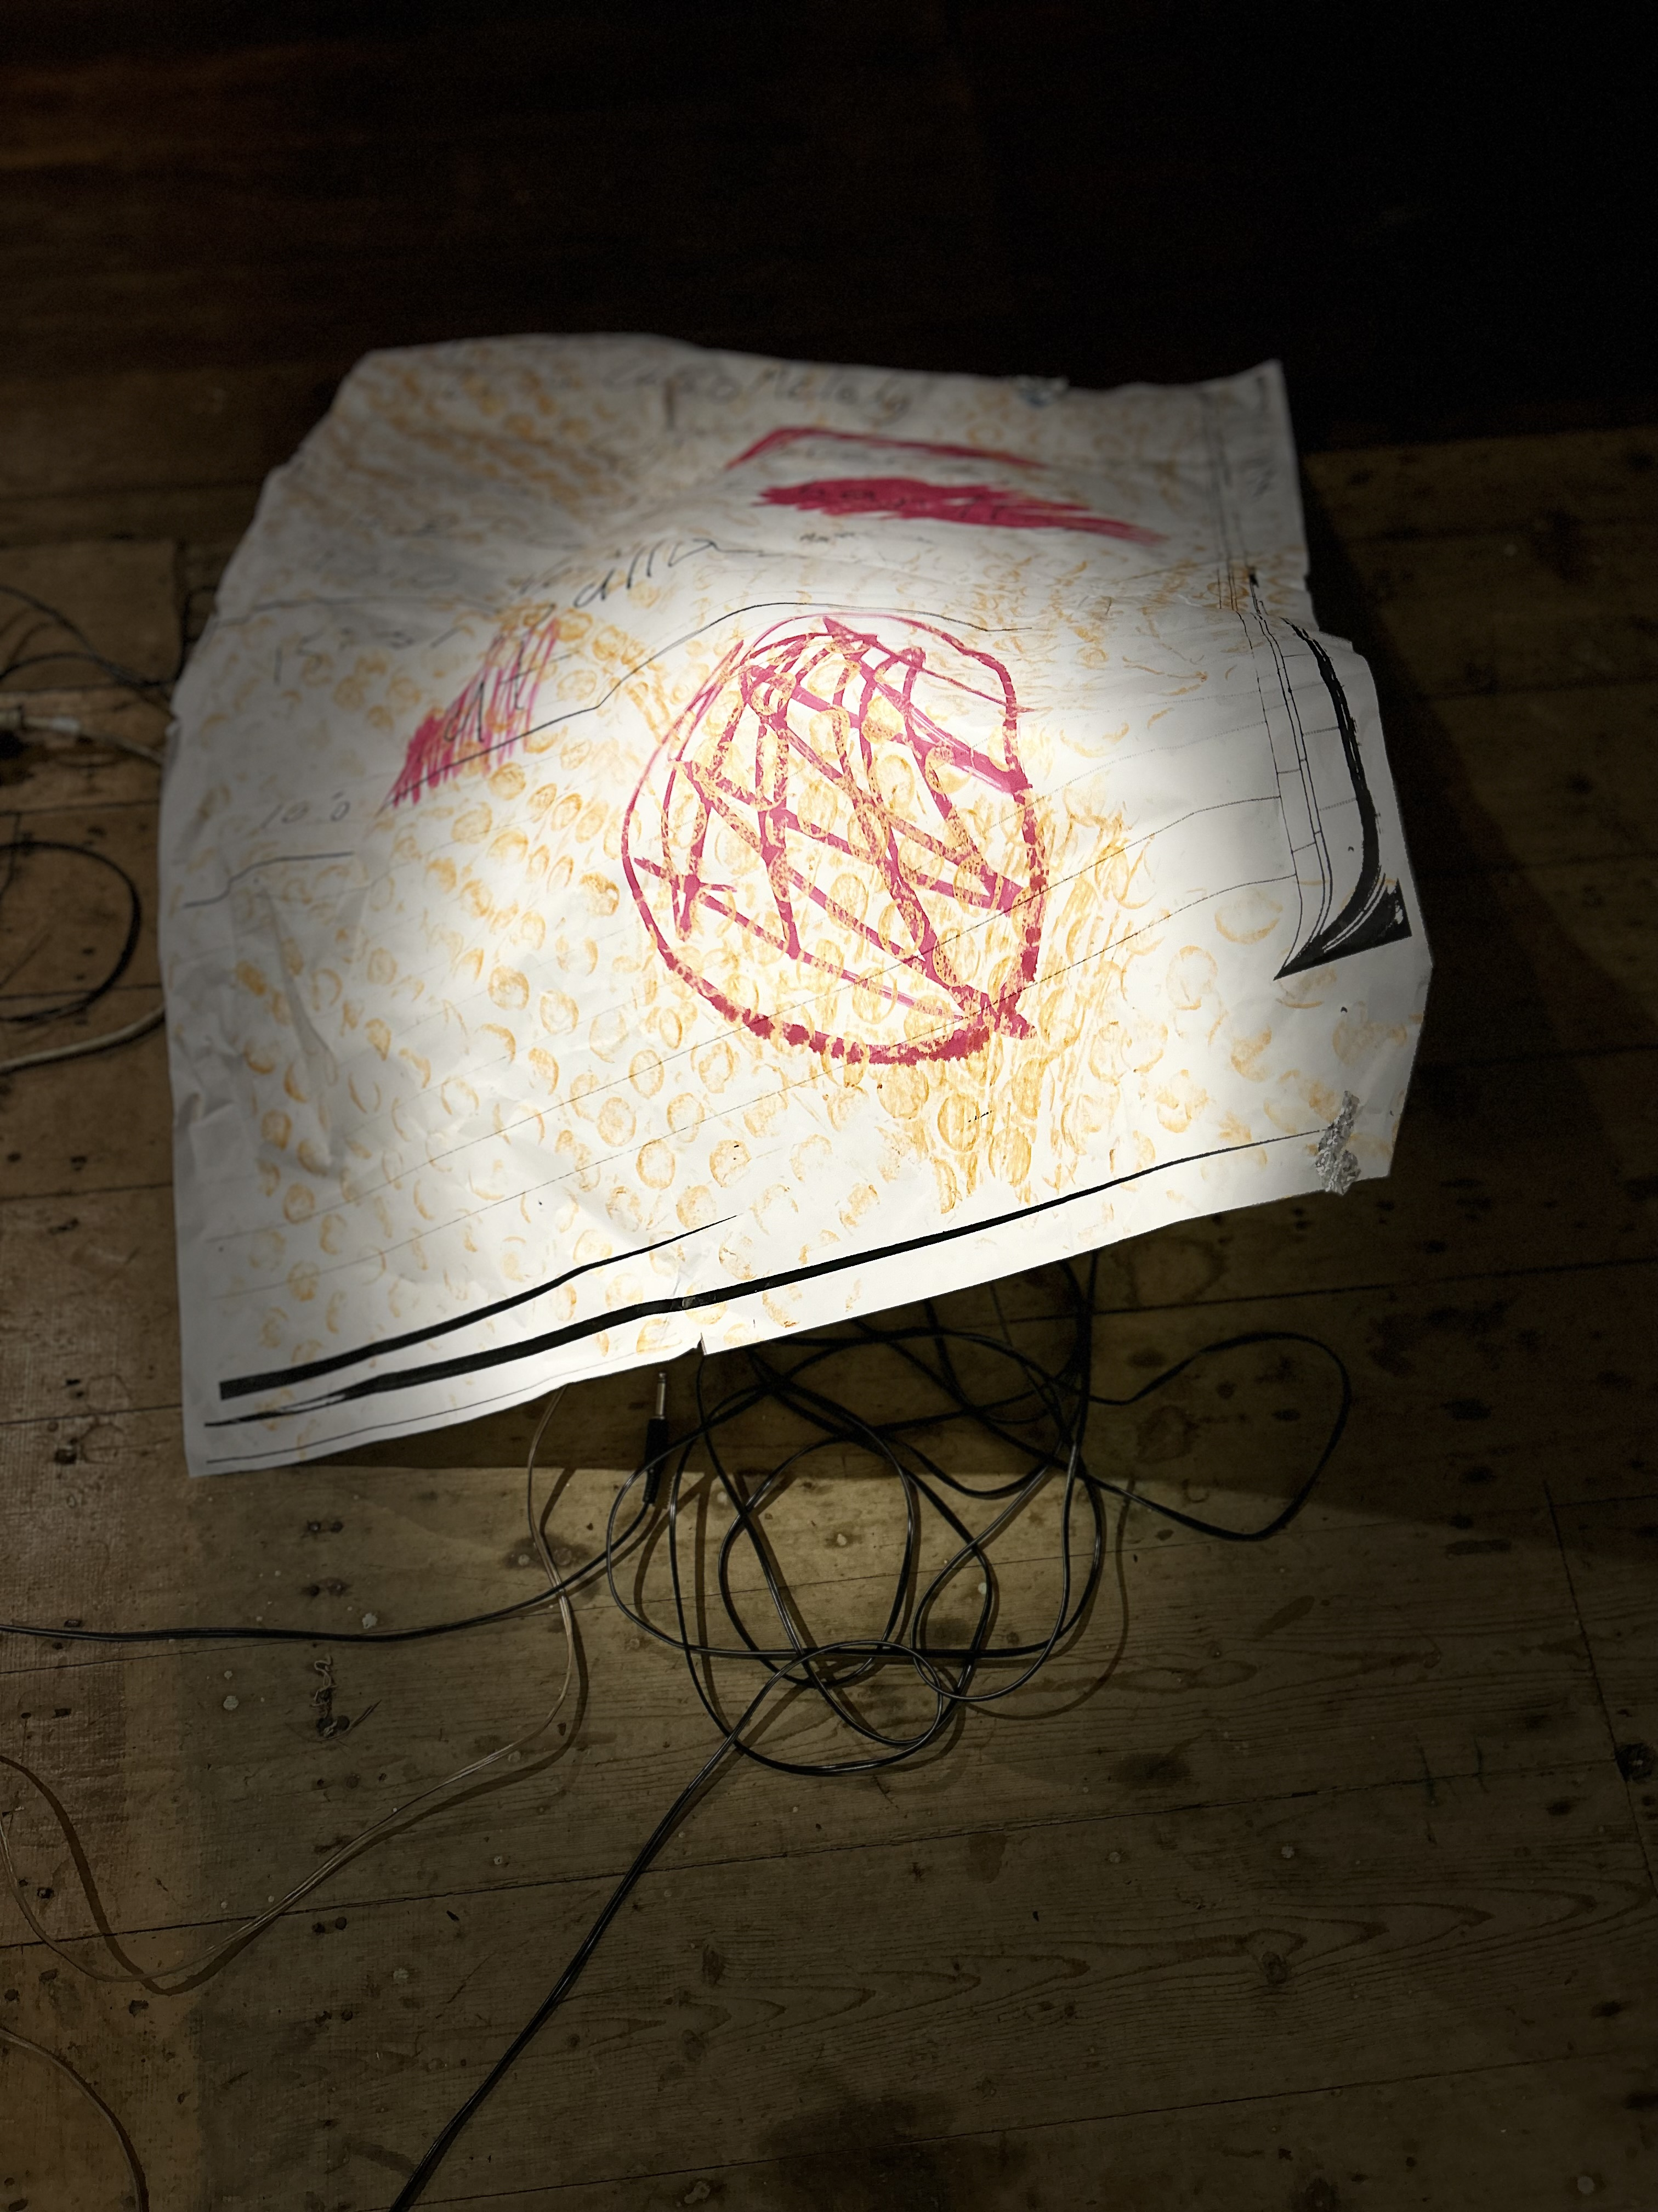
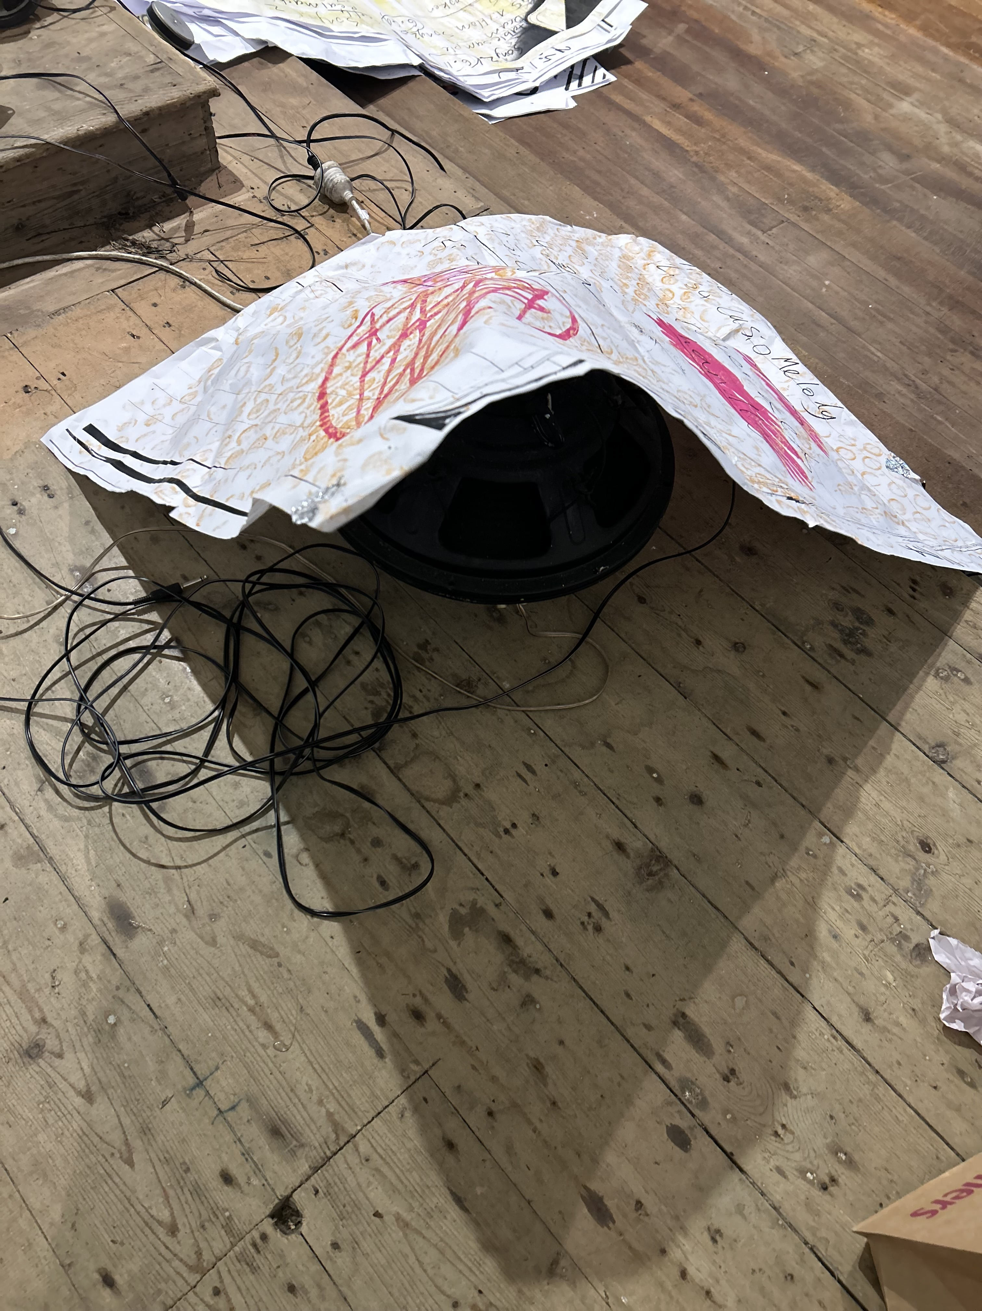
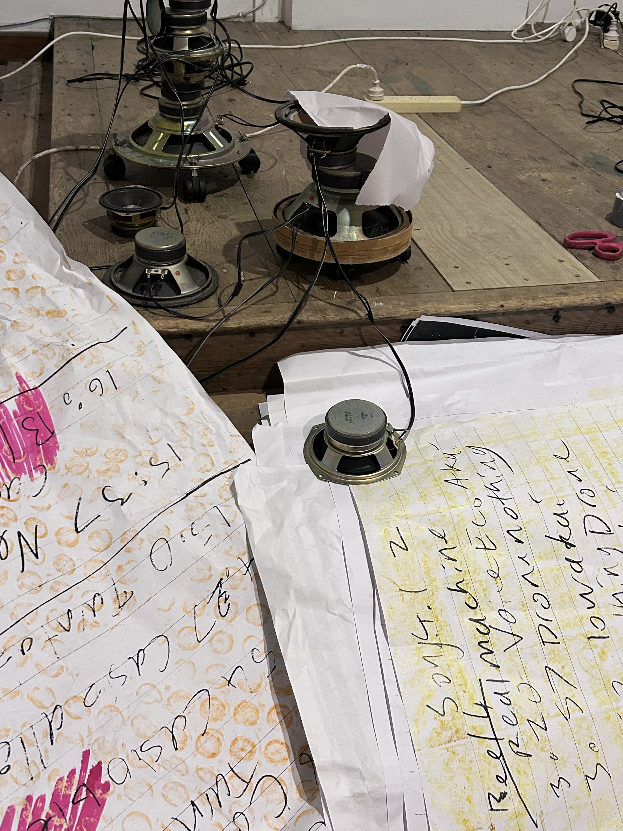

Slide 7
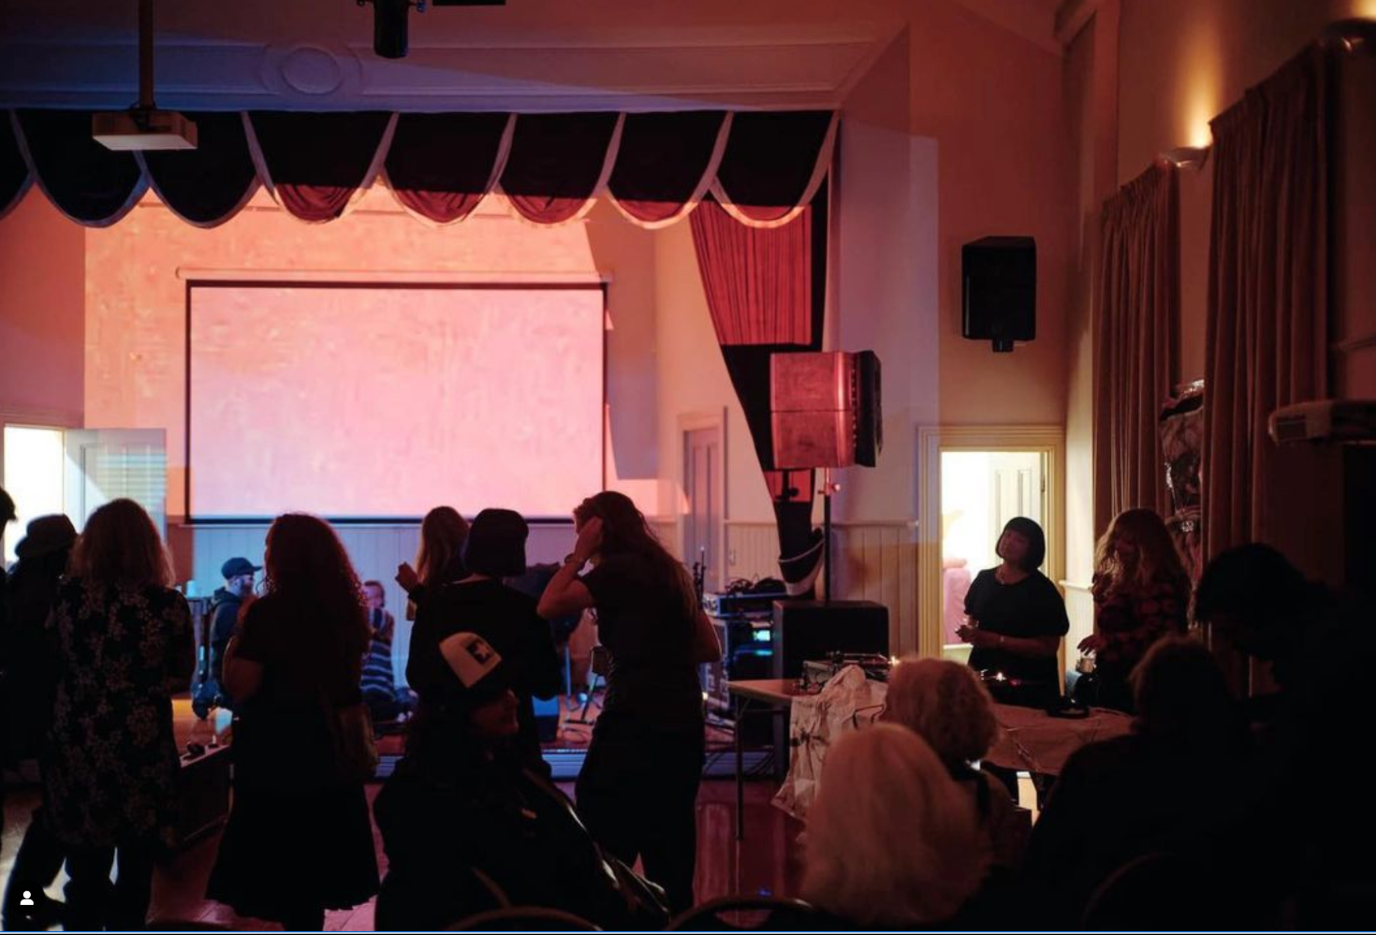
Uniform Mobile Disco at Lines of Flight 2023, Port Chalmers Town Hall. Photo by Fraser Thompson
On cultivating my radical attentiveness
“Deep Listening is exploring the relationships among any and all sounds whether natural or technological, intended, or unintended, real, remembered or imaginary. Thought is included. Deep Listening includes all sounds expanding the boundaries of perception.” Pauline Oliveros

Slide 8
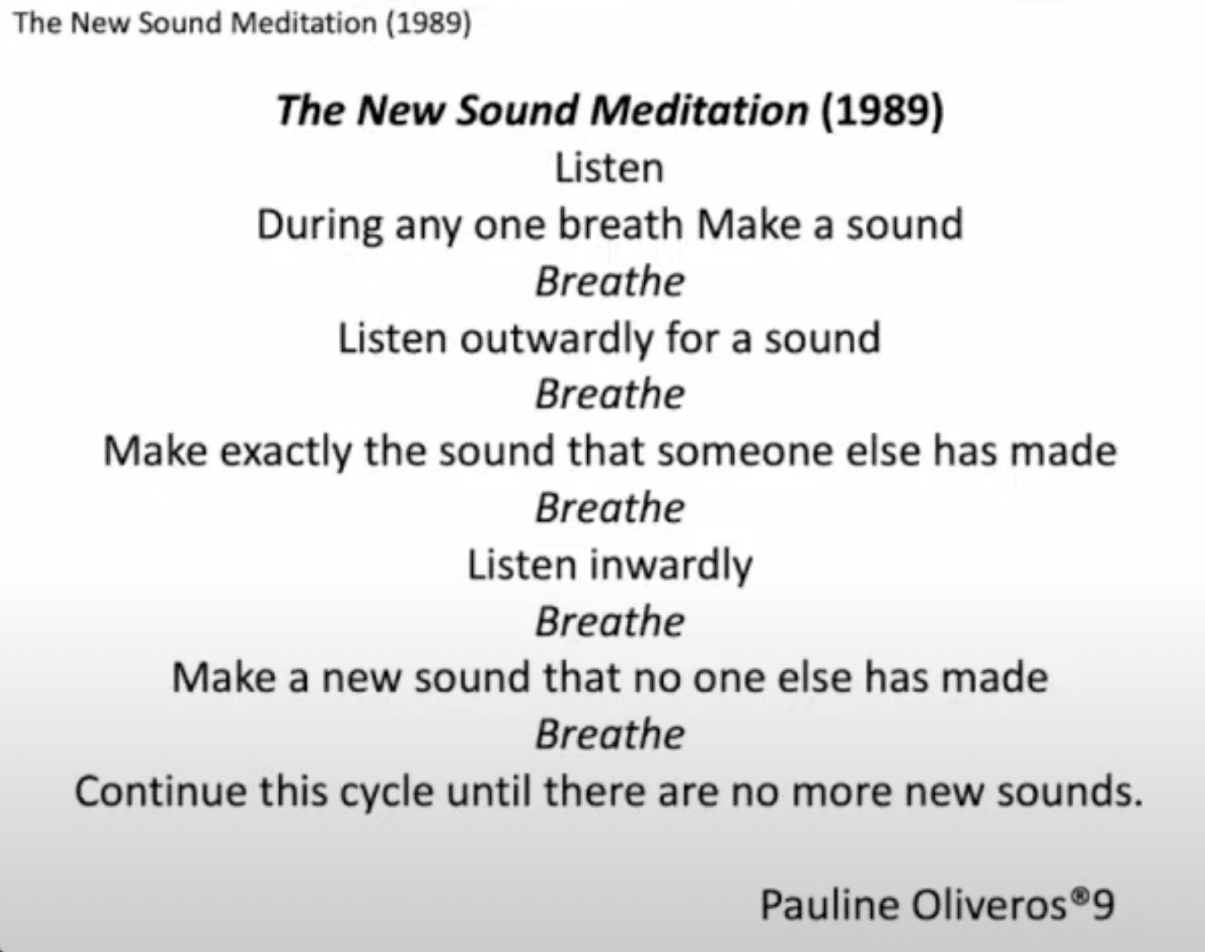
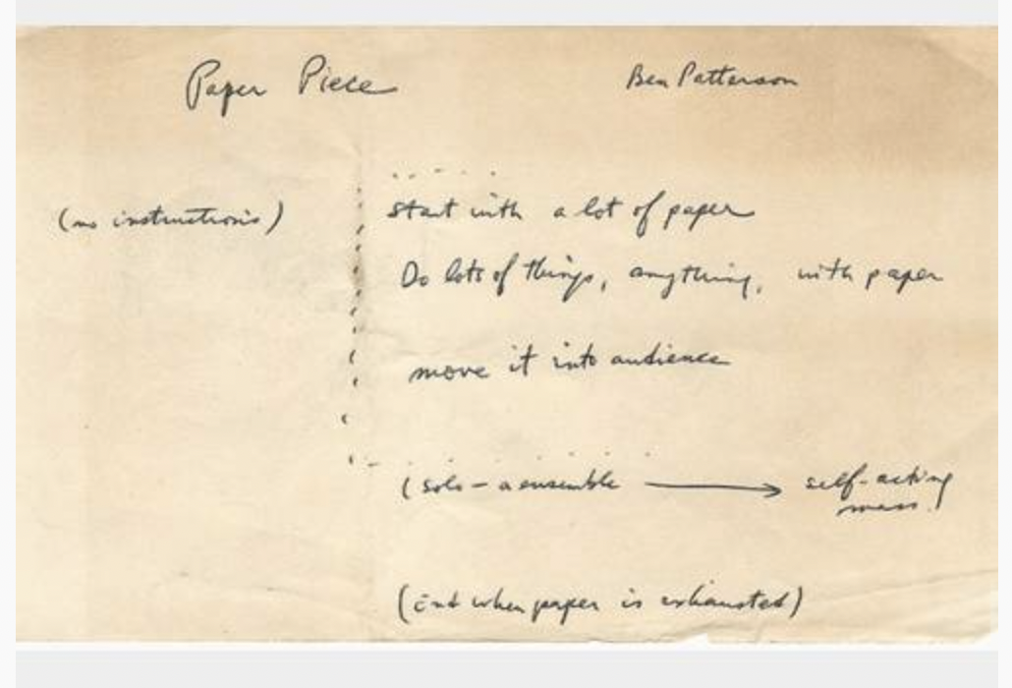
Benjamin Paterson
Paper Piece (1960)
Handwritten score, 10 x 16.5 cm. Signed
Archived in ring binder "B. Patterson. Performances

Slide 9
